Slide 1

Naufar Time Attendance System

Slide 2
IRIS Scan

Slide 3
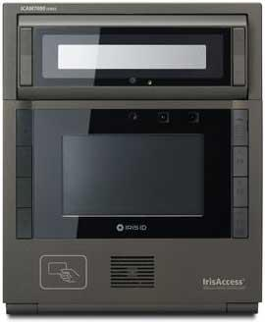






Iris Scan
User retina scan
User data match
Send data to DB
Enter your number
Match Scan
Scan
Store data
Attendance Data
Shift data to Attendance Server

Slide 4
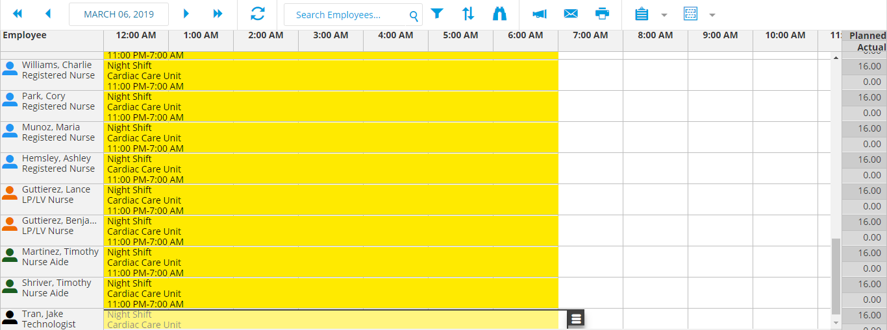
Scan/Punch View
Select Date
Select Unit
Search
Attendance Module
Employee shall punch in or punch out.
The system shall record and generate reports

Slide 5



Time Attendance System
User after login to Reporting module
Select required reports, select parameters and click to generate.
Browser
Match Scan
To Report
Search Employee
Mark attendance
Store data
Attendance Data

Slide 6
SAP inbound outbound

Slide 7

Admin Login Process
Login model
After verification logins to system
Dashboard on first view
Dashboard
Enter User Name
admin@naufar
**********
Login

Slide 8



Import Employee Master data
OUTBOUND
Web-service
Admin import Employee master data.
SAP web service provides the data
System connects to import data and shall saves to DB
Employee Management
Trigger:
Fetch Employees
SOAP Response
SOAP Request
Master data
Read SOAP XML
Generate XML
Extract data
Master Data Storage
Data Storage

Slide 9
Import Shift Definition
OUTBOUND
Web-service
Admin import shift definition master data.
SAP services provides the data
System connects to import data and shall saves to DB
Shift Management
Trigger:
Fetch Shifts
SOAP Response
SOAP Request
Master data
Read SOAP XML
Generate XML
Extract data
Master Data Storage
Data Storage

Slide 10
Public Holidays Import
OUTBOUND
Web-service
Admin import Holiday master data.
SAP services provides the data
System connects to import data and shall saves to DB
Holiday Management
Trigger:
Fetch Holiday
SOAP Response
SOAP Request
Master data
Read SOAP XML
Generate XML
Extract data
Master Data Storage
Data Storage

Slide 11
Check In/Out Export
INBOUND
Web-service
SAP Admin import check-in check-out from time attendance server via web service.
SAP services provides the data
System connects to import data and shall saves to SAP-DB
Attendance Web-service
Trigger:
Fetch Check in-out
Attendance Data
SOAP Response
SOAP Request
Generate XML
Read XML
Fetch data
Extract data
Store to master data
Master Data Storage
Data Storage

Slide 12
Roster data Export
INBOUND
INBOUND
Web-service
SAP Admin import Roster data from time attendance server via web service.
SAP services provides the data
System connects to import data and shall saves to SAP-DB
Roster Web-service
Trigger:
Fetch Check in-out
Roster Data
SOAP Response
SOAP Request
Fetch data
Read XML
Generate XML
Extract data
Store to master data
Master Data Storage
Data Storage

Slide 13

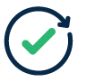
INBOUND Data Verification and Reporting
After importing data to SAP the data shall be verified for integrity.
Data Import Module
Web-service
Process Data
SOAP Request
SOAP Response
SUCCESS/FAILURE
Read XML
Generate XML
REPORT
Extract data
Fetch Data
Verification
Data Storage
Master Data Storage

Slide 14
Employee Master Data

Slide 15
Manager Login Process
Login model
After verification logins to system
Dashboard on first view
Dashboard
Enter User Name
manager@naufar
**********
Login

Slide 16
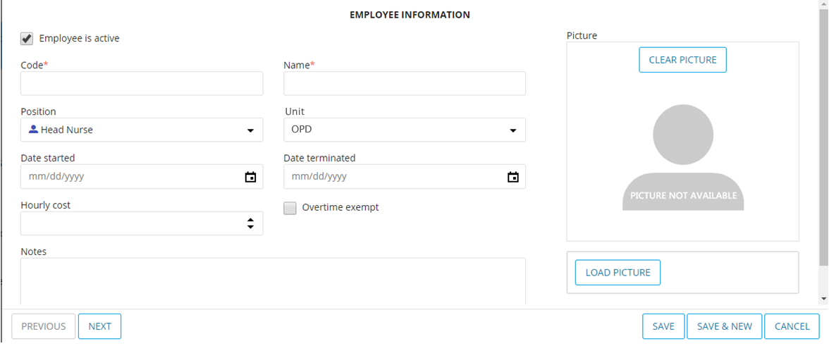
Employee Profile
Employee Name
Employee Code
Search
Employee Module

Slide 17
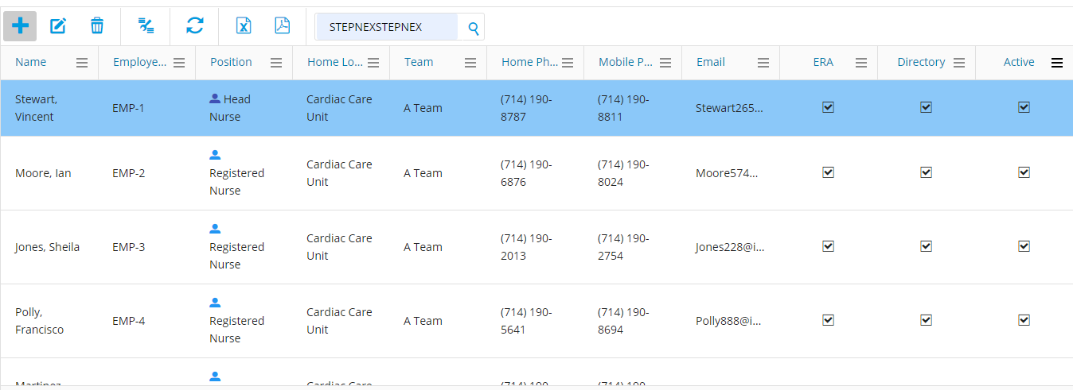
Employee View List
Emp: Name
Emp: Code
Search
Employee Module

Slide 18
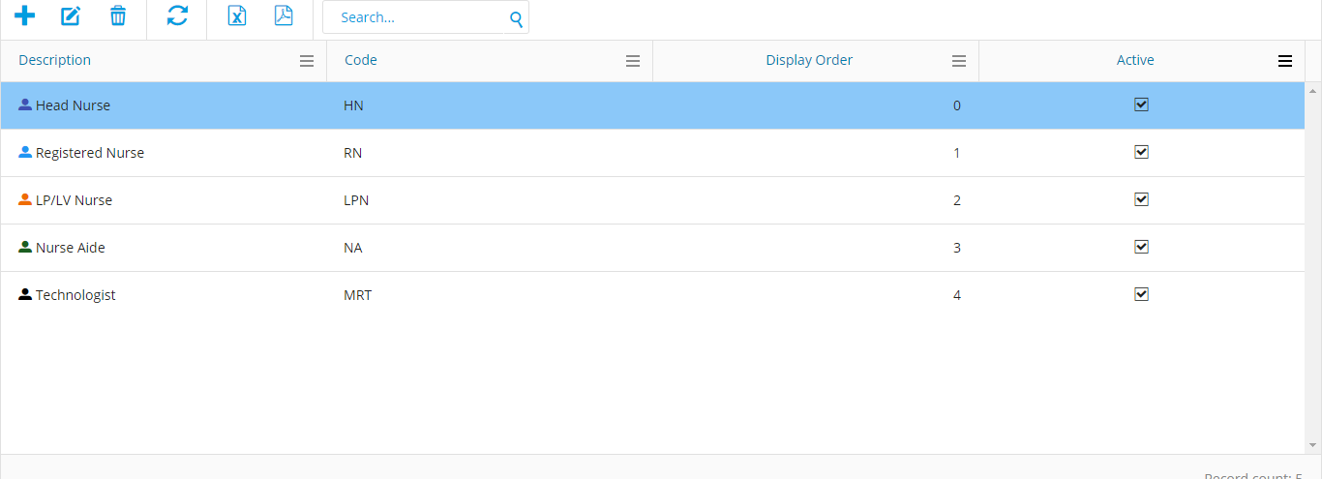
View Designation List
Designation List
Search
Designation Module

Slide 19
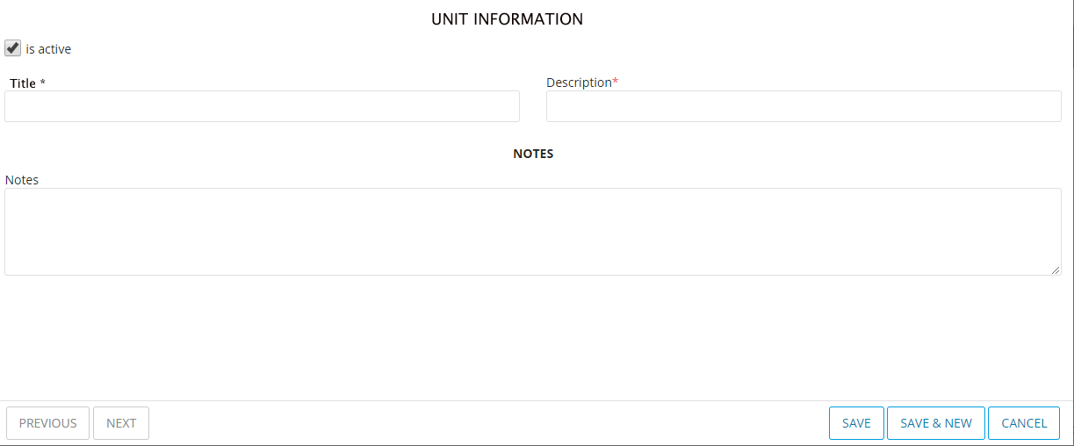
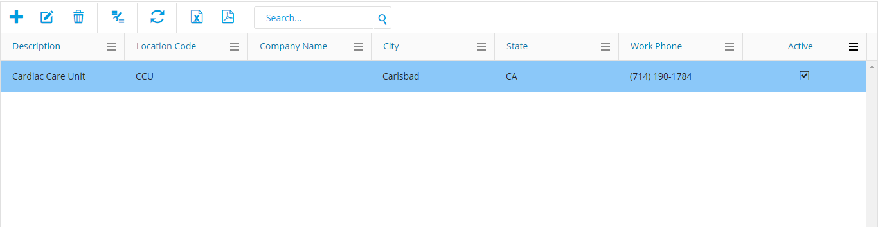
Unit Management
Unit Module
Select Add New
Open the new Add Unit form.
Fill the required fields
And submit to save.
Add Code
Add Description
Save Unit

Slide 20
Add Skills to Employee
Select Employee
Employee Skills
Skills Module
Emp..1
Emp..2
Emp..3
Emp..4
Emp..1
IV, Dialysis, Dressing
Emp..2
ICU, Injections, Dressing Emp..3
Injections, Dialysis, Dressing Emp..4
Injections, Dialysis, Dressing Emp..5
CCU, Injections, Dressing Emp..6
IV, Dialysis, Dressing
Select Shift
Morning
Evening
Night
Select Skill
IV
Injection
Dressing
Anesthesia
Select Unit
OPD
Residential
Surgical
Add Skill
Data Storage

Slide 21
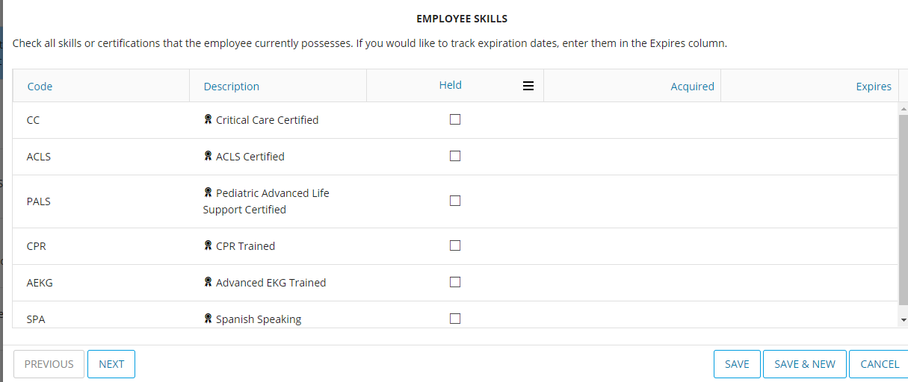
Skills View
Skill Title
Search
Skills Module

Slide 22
Shifts Rosters Creation

Slide 23
Shift Creation Process 1
Manager shall first calculate the number of staff required in each unit.
And number of staff required shall be note in below table
Select Req
STEP -1: DETERMINE THE NUMBER OF STAFF REQUIRED ON THE UNIT
Staff Req ..1
Staff Req ..2
Staff Req ..3
Staff Req ..4
Staff Req ..5
Staff Req ..6
Staff Req ..7
Staff Req ..8
Staff Req ..9
Week 1 | Grade Req: | Skills | Sun | Mon | Tue | Wed | Thu | Fri | Sat
Day Shift | A | IVx1 ICx1 | 2 | 2 | 2 | 3 | 2 | 2 | 3
Day Shift | B |  | 3 | 1 | 1 | 2 | 2 | 3 | 2
Evening Shift | A | IVx1 | 2 | 1 | 2 | 2 | 3 | 2 | 1
Evening Shift | A | ICx1 | 2 | 1 | 2 | 2 | 3 | 3 | 1
Night Shift | A | IVx1 ICx1 | 3 | 2 | 2 | 2 | 2 | 2 | 3
Night Shift | B | ICx1 | 2 | 2 | 3 | 2 | 2 | 3 | 3
IV = Intravenous IC = In Charge
Step 2

Slide 24
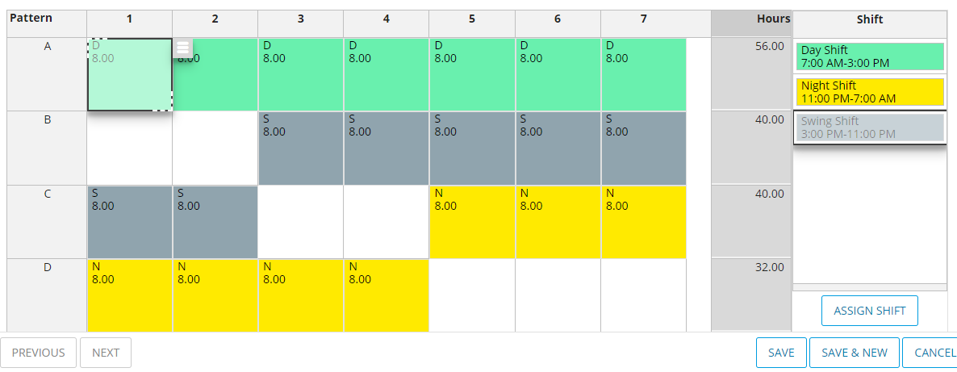
Shift Creation Process 2
Determine the length of the rotation.
Determine how many times the rotation will repeat itself.
Determine how many shifts must be worked.
Select Rotation
8 Hours Rotation
10 Hour Rotation
12 Hours Rotation
Rotation ..
Rotation ..
Rotation ..
STEP -2: DETERMINE THE PATTERN OF THE ROTATION
Step 3

Slide 25
Shift Creation Process 3
STEP -3: CREATE SHIFT
Select Shift and Unit
Select Employee from given list
And create the shift, the system shall check for error and will show as success and failure messages.
Shift Module
List of Employees
Select Skill
IV
Surgical
Dressing
System Check
Check for rules
Select Employee
Emp..1
Emp..2
Emp..3
Emp..4
Emp..5
Emp..6
Emp..7
Emp..8
Emp..9
Notification
Select Shift
Morning
Evening
Night
Success/Failure
Save
Select Unit
OPD
Residential
Surgical
Step 4

Slide 26
Shift Creation Process 4
Create shifts shall be displayed to Approver the approver shall check for any ambiguity and shall approve.
After approval the shift shall go live.
Shift go live
Pending Shift Approval
M-8-EMR-100433
E-8-EMR-100219
N-8-EMR-104345
M-8-OPD-100876
E-8-OPD-107654
N-8-OPD-100764
M-8-RES-100875
E-8-RES-100765
N-8-RES-100987
Shift Approver
Go live
Shift Manager
Data Storage

Slide 27
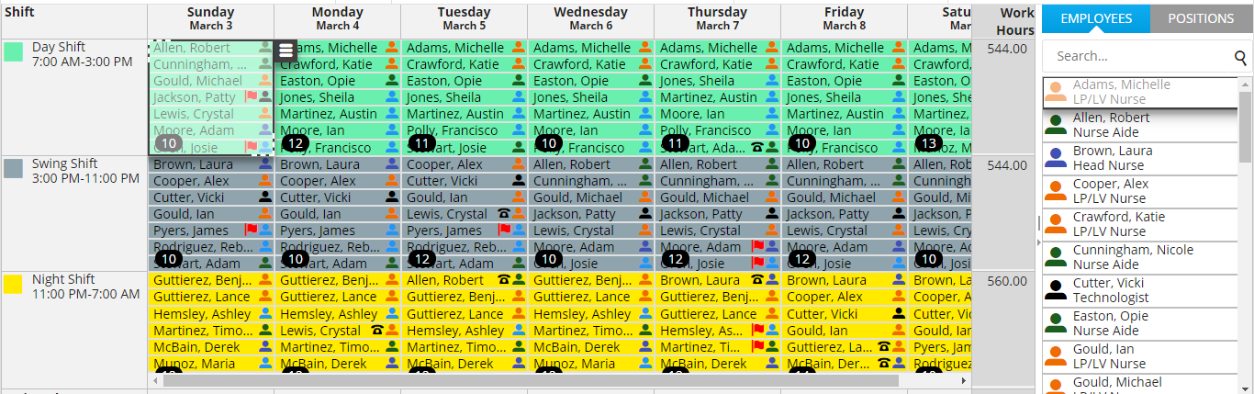
View Shift by day
Select Shift
Select Unit
Shift Module
Morning
Evening
Night
OPD
Residential
Surgical
View shift

Slide 28
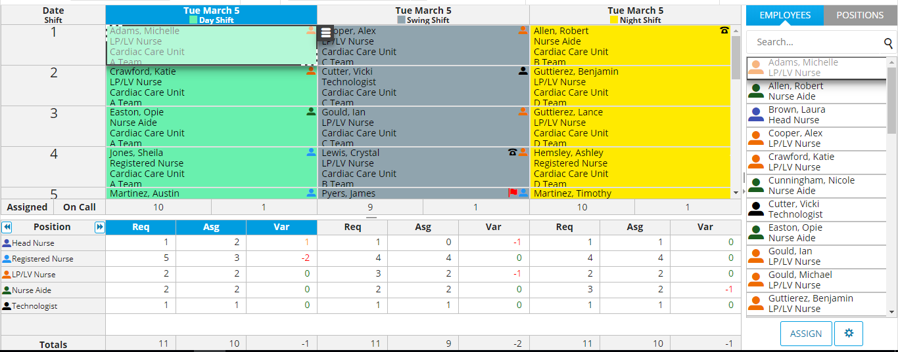
View Shift by Employee
Select Shift
Select Unit
Shift Module
Morning
Evening
Night
OPD
Residential
Surgical
View shift

Slide 29
Emails to Employees
Select shift and unit.
Select Employee/s
Write email body and click to send
Select Employee
Employee Module
Emp..1
Emp..2
Emp..3
Emp..4
Select Shift
Morning
Evening
Night
Email Subject
Email body
Select Unit
emp@naufar
OPD
Residential
Surgical
Send email

Slide 30
Shift Swap/Trade
Select shift and unit.
Select Employee who wants to Swap, and select Employee who is agreed to be swapped.
System check rules and swapped.
Select Employee A
Shift Module
Emp..1
Emp..2
Emp..3
Emp..4
Select Shift
Morning
Evening
Night
Get Approval
Select Employee B
Process Shift
Emp..1
Emp..2
Emp..3
Emp..4
Select Unit
Check conflicts
OPD
Residential
Surgical
Update shift
SWAP
Data Storage

Slide 31
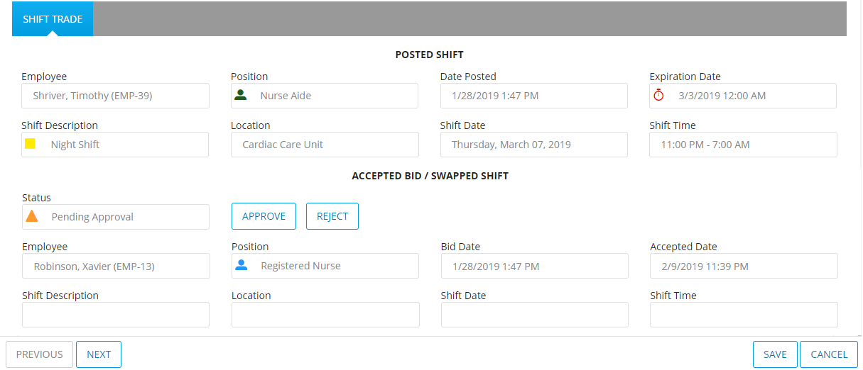
Shift Swap/Trade Interface

Slide 32

Thanks!
Any questions?
Prepared by Kcmran Kcan

